Slide 1
Ch01_Introduction

Slide 2
Class Operation
Lecture : Professor Edward Youngil Kim, Off-Line
Class Operation:
- Time & Room : 9:00~12:00(3 Hrs.) Tue, S2-402
- Operation(Plan) : Lecture(50%), Student Presentation(20%), Practice(30%)
- Student : AI. Big Data Department (Junior-3rd Grade)
- 2023. 3/7 ~ 6/13 (15 Weeks)
- 5/6(Saturday) → 6/8 or 6/9(Make-Up)
Evaluation
- Attendance : 20%
- Homework & Attitude: 10%
- Mid-term Test : 30%
- Final Test : 40% ⬅ Will be replaced with Project Completion Report and Presentation
of PBL(Project-Based Learning) Class
Contact : kim01okja@naver.com, 010-9530-5720, 042-630-9962
W19-205 (Endicott, Use left stairways in Lobby)
(Consulting Career/Job/Start-Up On/Off-Line)

Slide 3
Schedule
Week | Date | Contents
Week 1 | 3/7 | 1 Introduction to Operating Systems
Week 2 | 3/14 | 2 Hardware and Software Concepts
Week 3 | 3/21 | 3 Process Concepts
Week 4 | 3/28 | 4 Thread Concepts
Week 5 | 4/4 | 5 Asynchronous Concurrent Execution
Week 6 | 4/11 | 6 Concurrent Programming
Week 7 | 4/18 | 7 Deadlock and Indefinite Postponement
Week 8 | 4/25 | Mid-Term Exam
Week 9 | 5/2 | 8 Processor Scheduling
Week 10 | 5/9 | 9 Real Memory Organization and Management
Week 11 | 5/16 | 10 Virtual Memory Organization
Week 12 | 5/23 | 11 Virtual Memory Management
Week 13 | 6/30 | 12 Disk Performance Optimization
Week 14 | 6/8 or 6/9 | 13 File and Database Systems
Week 15 | 6/13 | Final Exam
Will be replaced with PBL

Slide 4
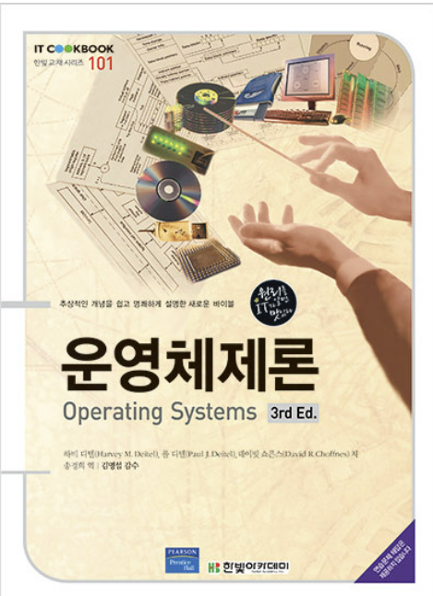
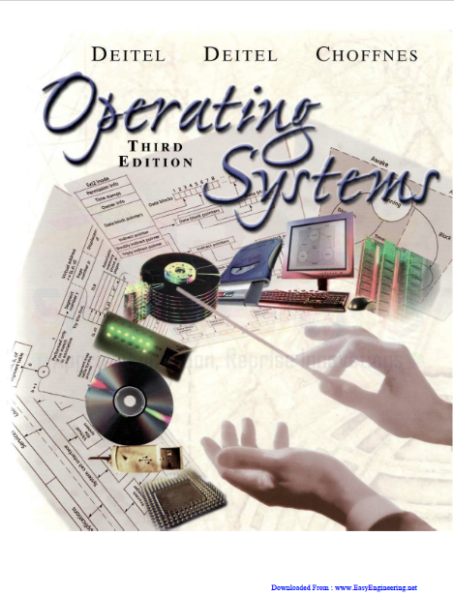
Textbook
- English :
Operating Systems, 3rd Ed.,
Harvey M. Deitel(HMD), Paul J. Deitel,
David R. Choffnes
Pearson Education/2004
- Korean
운영체제론,
Harvey M. Deitel and Others 저,
송경희역,
한빛아카데미/2020

Slide 5
Contents
01_Introduction
02_What is an Operating System?
03_Early History: The 1940s and 1950s
04_The 1960s
05_The 1970s
06_The 1980s
07_History of the Internet and World Wide Web
08_The 1990s
09_2000 and Beyond
10_Application Bases
11_Operating System Environments
12_Operating System Components and Goals
13_Operating System Architectures
[Objectives] You should understand:
• what an operating system is.
• a brief history of operating systems.
• a brief history of the Internet and
the World Wide Web.
• core operating system components.
• goals of operating systems.
• operating system architectures.

Slide 6
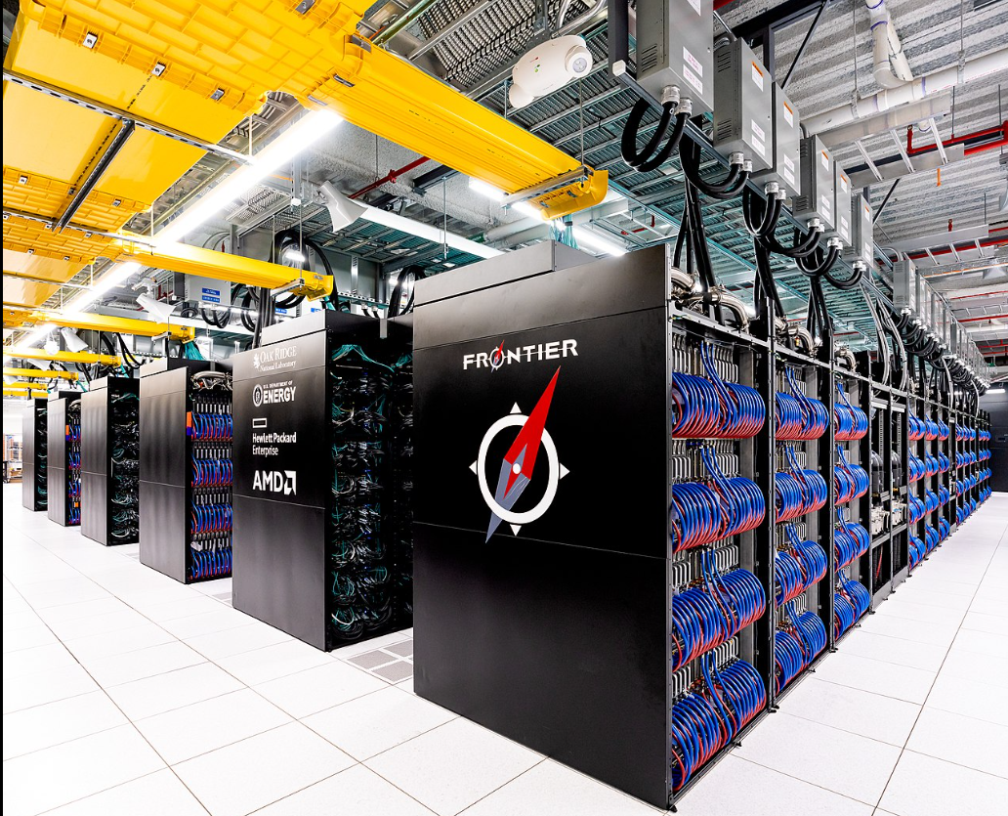
01_Introduction
Computing power - Evolving as an unprecedented pace
Current processing speed (Year 2004)
Desktop workstation - BIPS(Billions of Instructions per second)
Supercomputer - TIPS(Trillions of Instructions per second)
Fugaku-7.3 million cores(2020) Frontier-a speed of 1,102 PetaFLOPS (2022)
Use computers in almost every aspect of our lives
Reshaping the roles and responsibilities of OS
Desktop PC - Documentation, Game, Music, Video, Finance Management
Portable Devices - Notebook, PDA, Cell Phone, MP3
Wired&Wireless N/W, Internet&WWW, N/W Computer
What does this book review and discuss?
Principles of OS
Structure and responsibility of OS
Design consideration of OS
Performance, Fault Tolerance, Security, Modularity and Cost
Recent OS design issue in distributed computing, Internet and WWW
= record-breaking

Slide 7
02_What is an Operating System?
In the 1960s – the Software that controls the hardware
A S/W that enables applications to interact with a computer's H/W
Manages the software and hardware to produce the desired result
Resource Manager
Hardware
Processors
Memory (Main & Secondary)
Input/Output Devices
Communication Devices
Software
Applications
Other software abstractions such as an virtual machines

Slide 8
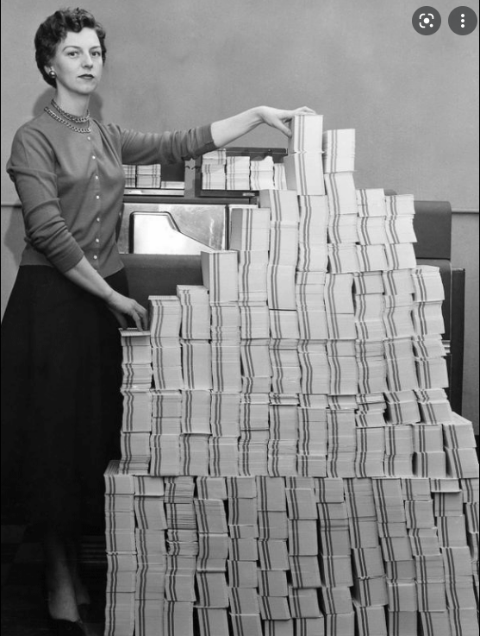
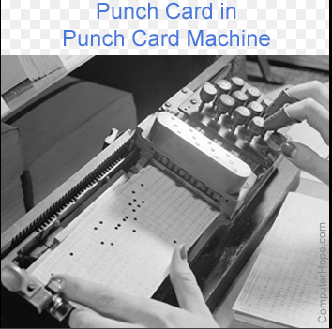
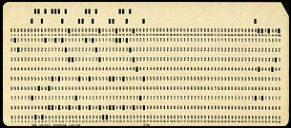
03_Early History: The 1940s and 1950s
OS has evolved over the last 80 years through several distinct phases
The 1940s
No OS in electronic digital computer
Mechanical switch - entered machine-language program one bit at a time
Punched card – punched machine-language program
Assembly language – English-like abbreviations
The 1950s
Implemented the first OS (IBM 701)
Executed one job(the set of program instructions) at a time
It is a single-stream batch-processing system
Programs and data were submitted in groups or batches by loading them consecutively onto tape or disk
Programmers directly control system resources(memory, I/O device)

Slide 9
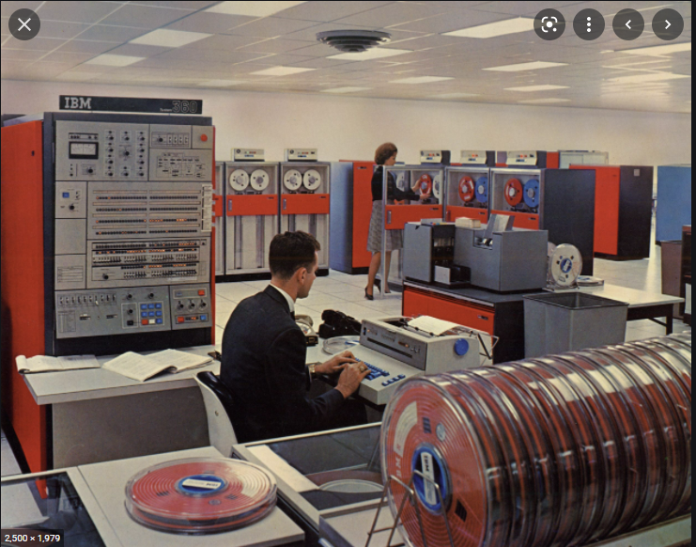
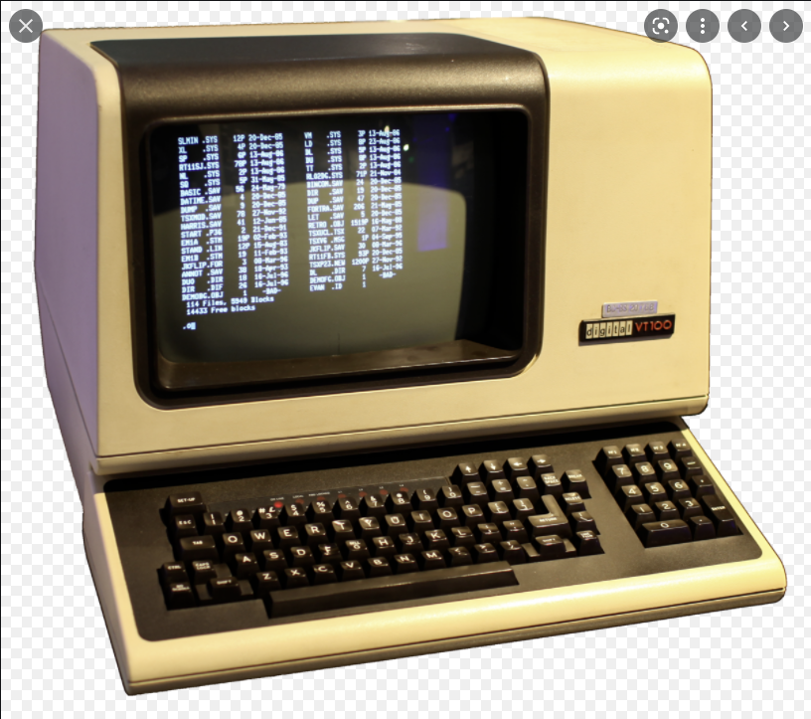
04_The 1960s
Batch-Processing Systems
Running several jobs at a time
Multi-Programming
Resource Sharing
Share the processor among a set of process(job)
Switches the processor from job to job
IBM announced System/360(1964) → 370 → 390…
Interactive users using “Dumb Terminal”
Timesharing System
Support interactive computing, Sharing program and data
MIT CTSS(Compatible Time-Sharing System)
IBM TSS(Time Sharing System)
CTSS → Multics(MIT/GE/Bell-Lab) : Used terminology “process” first
CP/CMS(Control Program/Conversational Monitor System) → Virtual Machine(IBM)

Slide 10
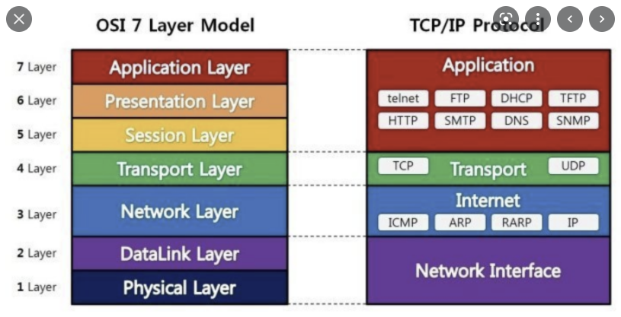
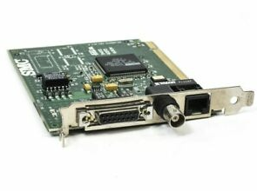
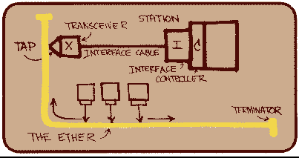
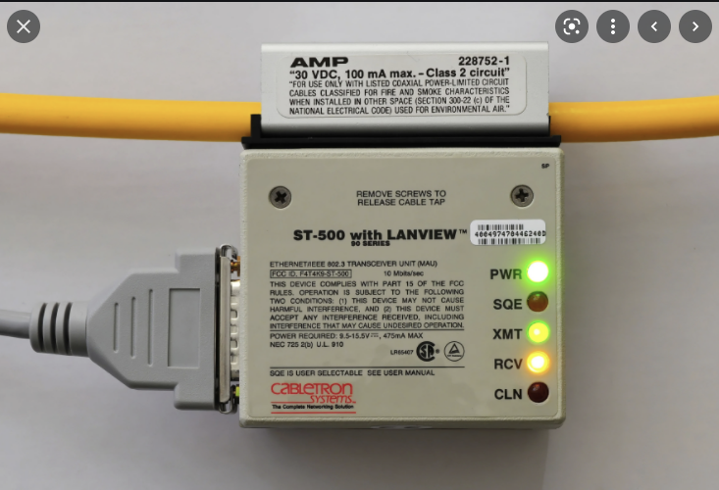
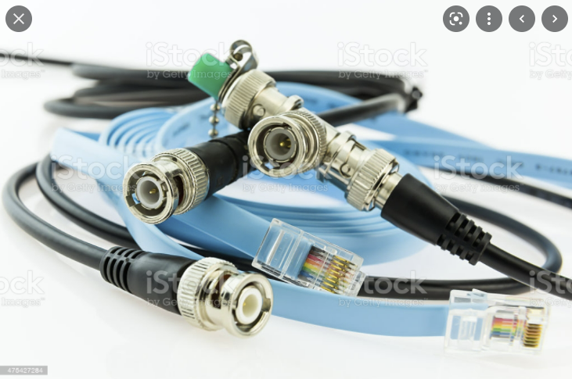
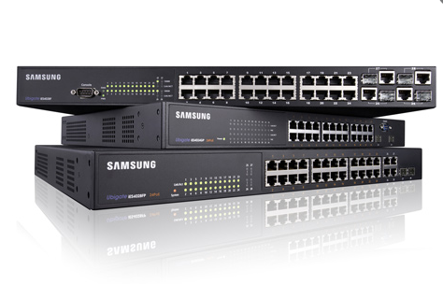
05_The 1970s
OS is multimode multiprogramming system
Support batch processing, timesharing, real-time application
Revolution of Personal Computing (the late 1970s, Apple II)
TCP/IP Communication Standard (DoD)
LAN – Ethernet (Xerox, Palo Alto Research Center)
Introduced Security Problem
Attention of Data Encryption/Decryption Technology
O/S includes networking and security features
O/S improves in performance to meet commercial demand

Slide 11
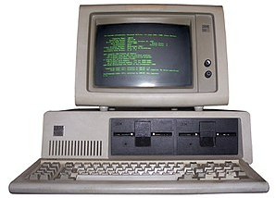
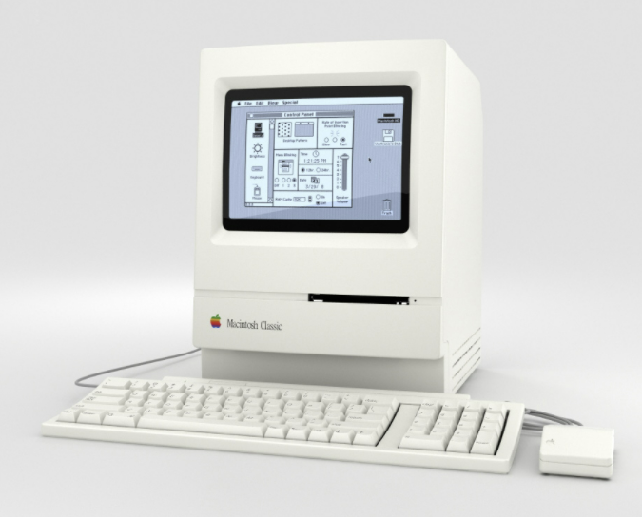
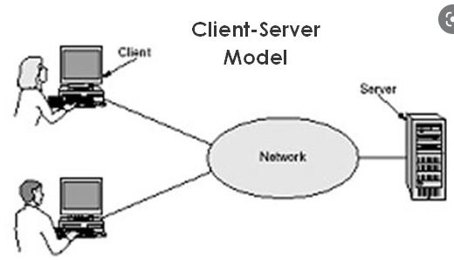
06_The 1980s
Decade of the personal computer and the workstation
Evolved microprocessor technology to the level of 1970s mainframe
IBM PC(1981), Apple Macintosh(1984)
New Application Software
Spreadsheet, Word Processor, Database, Graphic Package
Introduced GUI(graphical user interface)
Easy to learn and use
Window, Icon, Menu, Mouse
Developing Computer Network
Transferring information between computers became more economical and practical
Electronic Mail, File Transfer, Remote Database Access
Widespread client/server computing model
Provide distributed computing environment
Evolved software engineering

Slide 12
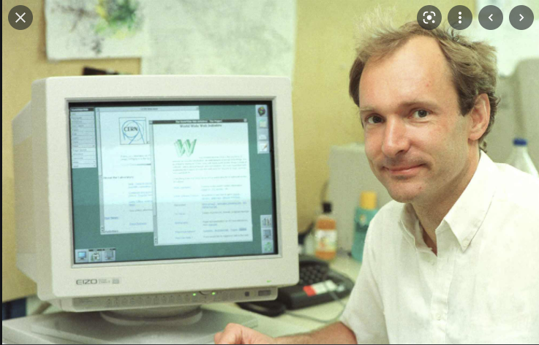
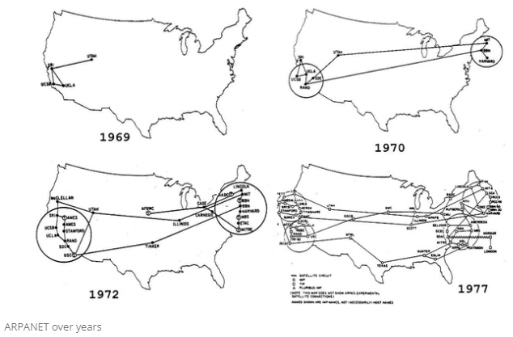
07_History of the Internet and WWW
ARPA(Advanced Research Project Agency)
ARPAnet → Internet
The grandparent of today’s Internet
Quick and easy communication
Operate without centralized control
Route data packets from senders to receivers over alternative paths even if a portion of network fails
TCP/IP Protocol
Communication Protocols over the ARPAnet
Error-proof message(data) delivery
Open to Commercial Purpose
Concerned the saturation but the opposite
Increased Bandwidth
Decreased H/W and Communication Cost
World Wide Web(WWW)
In 1989, Tim Berners-Lee of CERN developed a technology for sharing information via hyperlinked text documents (HTML, HTTP)
User can view multimedia-based documents on almost any subject
European Center for Nuclear Research
HyperText Markup Language
HyperText Transfer Protocol

Slide 13
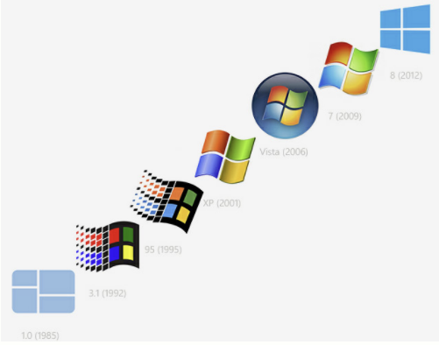
08_The 1990s
The 1990s Distinct Characteristic
Exponential improvement of H/W performance
Dramatically increase of processing power(MIPS~TIPS) and storage(Gbytes)
WWW led to an explosion in the popularity of distributed computing
Distributed computing became commonplace among personal computers
Use distributed computing to scale resource use and increase efficiency
Relatively slow N/W speeds compared to the internal processing speeds of PCs
A growth of Microsoft
DOS OS(1981), Windows OS(the mid-1980s), Windows 3.0(1990) ~ Windows 98
Windows provides user-friendly interface borrowed from Machintosh
Dominated desktop OS market
Announced Window NT for corporate OS market(1993)
Object Technology (Language – C++, Java, .Net)
The OO Program makes programmer reuse component and reduce coding time
The object-oriented concept makes the OOOS easier to maintain and extend than previous OS
Open Source Movement
The movement toward open-source software
Linux, Apache, FreeBSD and etc.-free under GPL(General Public License)

Slide 14
09_2000s and Beyond
Middleware
A software that links two separate applications over a network
Web Server, Network S/W, Messaging S/W and etc.
Web Service
Enable any two applications to communicate and exchange data via the Internet
Drive the shift toward distributed computing
Multiprocessor and Network Architectures
Creating numerous opportunities for research and development of new H/W and S/W design techniques
Massive Parallelism
Many independent parts of computations can be performed in parallel using large number of processors
OS are standardizing UI and API
Makes easier to use and support a great number of programs
Windows XP merged the consumer and professional lines
Linux employs standard API such as POSIX(Portable OS Interface)

Slide 15
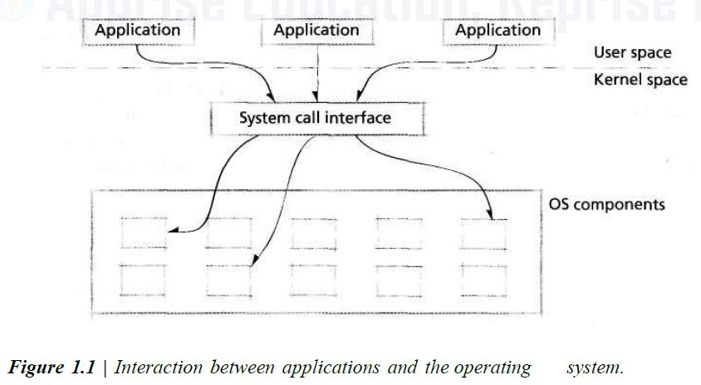
10_Application Bases
IBM PC spawned a huge S/W industry
ISVs(independent software vendors) were able to make and sell S/W packages for the IBM PC to run under the MS-DOS
OS became Bases of Applications
OS free application S/W developers from manipulating computer H/W
Provides API calls which a user program instructs the OS to do the work
Application developer simply calls a specific routine(system calls)

Slide 16
11_OS Environments (1/3)
General-purpose Computers
Including high-capacity main memory and disk, high-speed processor, various peripheral devices and etc.
Personal Computers and Workstations
High-end Web Server and Database Server containing high-performance HW
Embedded Systems
Manage a small set of specialized resources that provide functionality to devices such as Home appliances, N/W equipment and Cell Phones
Efficient resource management is the key
Must provide services using a minimal amount of code
Consider Power management
Consider User-friendly interface
Real-time Systems
Must perform a task within a particular(often short) time frame
Soft Real-time system – high priority but the best effort
Hard Real-time system – guarantee on time
Mission-critical system – air traffic control
Business-critical system – e-business

Slide 17
11_OS Environments (2/3)
Virtual Machine(VM)
A S/W abstraction of a computer – execute as a user application on top of the native OS
Virtual Machine OS
Manage the resources provided by the virtual machine
Application of Virtual Machine
Allow multiple instances of OS to execute concurrently
Emulation
Mimics the functionality of HW or S/W not present in the system
Multiple users share H/W
Promote portability – the ability for S/W to run on multiple platforms
Java Virtual Machine(JVM)
JVM allows Java applications to execute on any JVM regardless of the platform
VMware – provides VMs, particularly for the Intel architecture

Slide 18
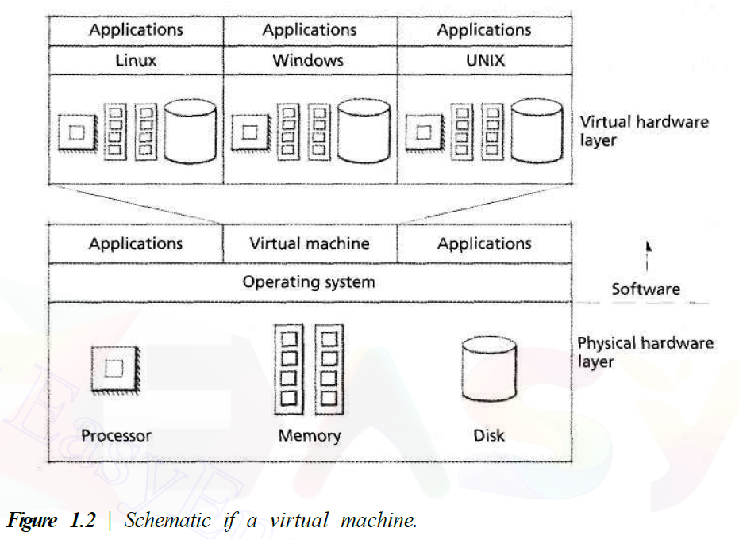
11_OS Environments (3/3)
Virtual Machine(VM)

Slide 19
12_OS Components
Core OS Components (Kernel)
Process Scheduler
When and for how long a process execute on a processor
Memory Manager
When and how memory is allocated to processes and what to do when main memory becomes full
I/O Manager
Services input and output requests from and to hardware devices, respectively
Intercrosses Communication(IPC) Manager
Allows processes to communicate with one another
File System Manager
Organizes named collections of data on storage devices and provides an interface for accessing data on those devices

Slide 20
12_OS Goals
OS Goals
Efficiency
High throughput and low average turn-around time
Robustness
Fault tolerant and reliable
Scalability
Use resources as they are added
Extensibility
Adapt well to new technologies and provide capabilities to extend the OS to perform tasks beyond its original design
Portability
Operate on many HW configurations (OS and applications)
Security
Prevents users and software from accessing services and resources without authorization
Interactivity
Allows applications to respond quickly to user actions, or events
Usability
Has the potential to serve a significant user base and generally provide an easy-to-use user interface (Linux, Windows, MacOS)

Slide 21
13_OS Architecture (1/5)
Today’s OSs tend to be complex because
Provide many services
Support a variety of HW and SW resources
OS Architectures
Monolithic Architecture
Layered Architecture
Microkernel Architecture

Slide 22
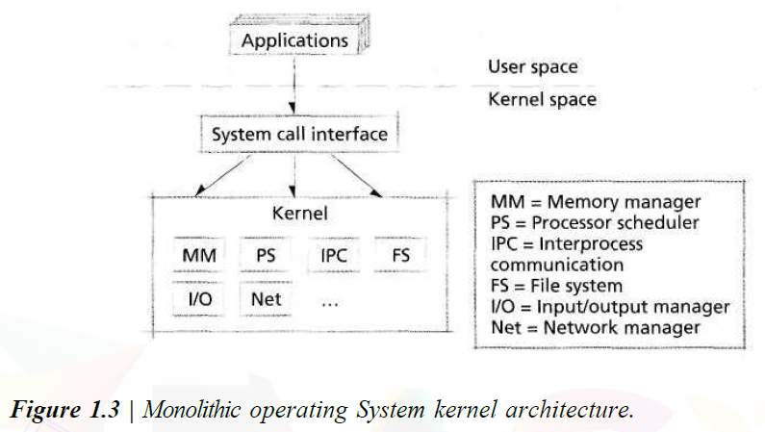
13_OS Architecture (2/5)
Monolithic Architecture
Every components of the OS is contained in the kernel
Communicate with any other components using function calls
Unrestricted access to the computer system
Achieve high efficiency
Susceptible to damage from errant and malicious code

Slide 23
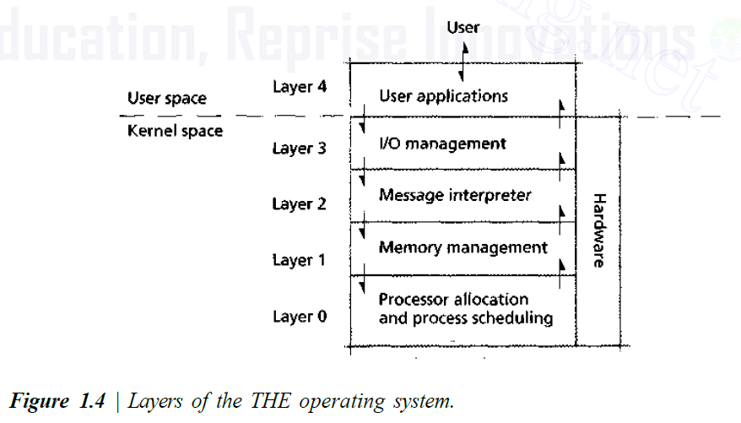
13_OS Architecture (3/5)
Layered Architecture
Grouping components that perform similar functions into layers
Each layer communicates with layer immediately above and below it
Lower level layers provide services to higher-level ones using an interface that hides their implementation
Modularity imposes structure and consistency on the OS
Simplifying SW validation, debugging and modification
Performance degrades compared to that of a monolithic kernel

Slide 24
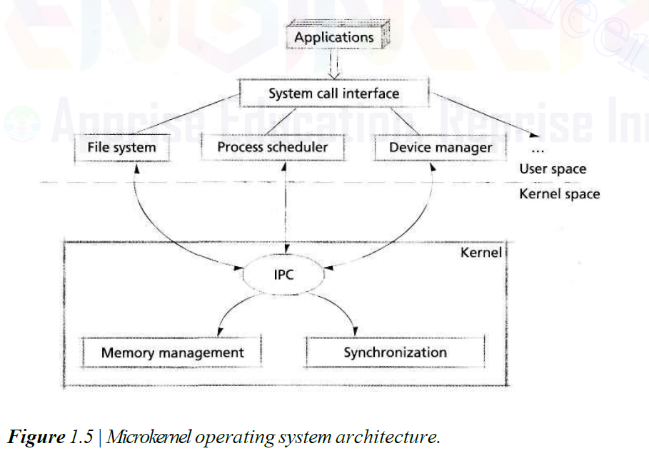
13_OS Architecture (4/5)
Microkernel Architecture
Provides only a small set of services in kernel
To keep the kernel small and scalable
Includes only low-level memory management, IPC and basic process synchronization for cooperation
Some components(Fig. 1.5) execute outside the kernel with a lower privilege level
Exhibit a high degree of modularity, making them extensible, portable and scalable
Heavy inter-module communication can degrade system performance

Slide 25
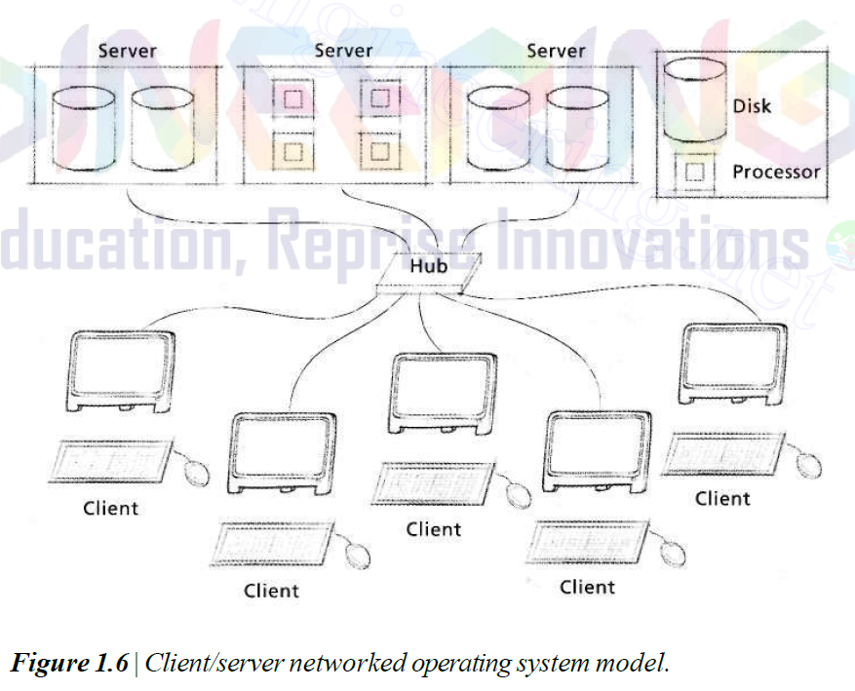
13_OS Architecture (5/5)
Networked and Distributed OS
Network OS
Enables its processes to access resources that reside on other independent computers on a network
Network file system (ex, SUN’s NFS)
Distributed OS
A single OS that manages resources on more than one computer system
Difficult to implement
Require complicated algorithms to enable processes to communicate and share data

Slide 27
Survey
Personal Survey To Build Up Team
Name : | Contact :
Department : | School Year :
Question | Strongly Disagree | Disagree | Neutral | Agree | Strongly Agree
① I faithfully carry out the role given. (나는 주어진 역할을 충실히 수행한다.)
② I actively participate in meetings for assignments. (나는 과제를 위한 모임에 적극적으로 참여한다.)
③ I am considerate of others. (나는 다른 사람을 잘 배려해 준다.)
④ I express my opinion actively. (나는 내 의견을 적극적으로 표현한다.)
⑤ I can amuse the atmosphere of the small group. (나는 소집단의 분위기를 즐겁게 할 수 있다.)
⑥ I can conduct meetings well in small group activities. (나는 소집단 활동 시, 회의를 잘 진행할 수 있다.)

